Slide 1
Introduction To ML
-Rushikesh dhande

Slide 2
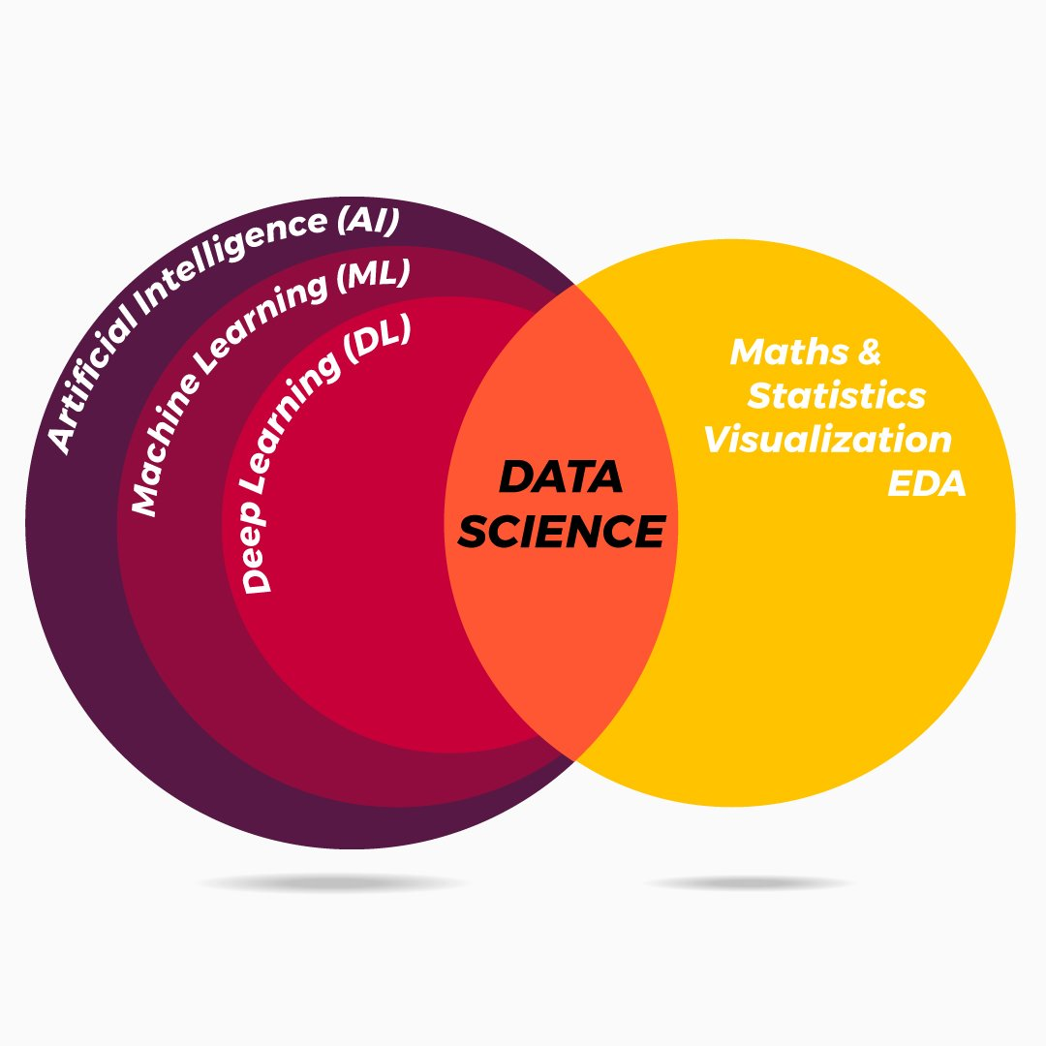
AI,ML,DL,DS

Slide 3
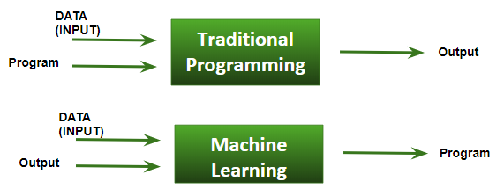
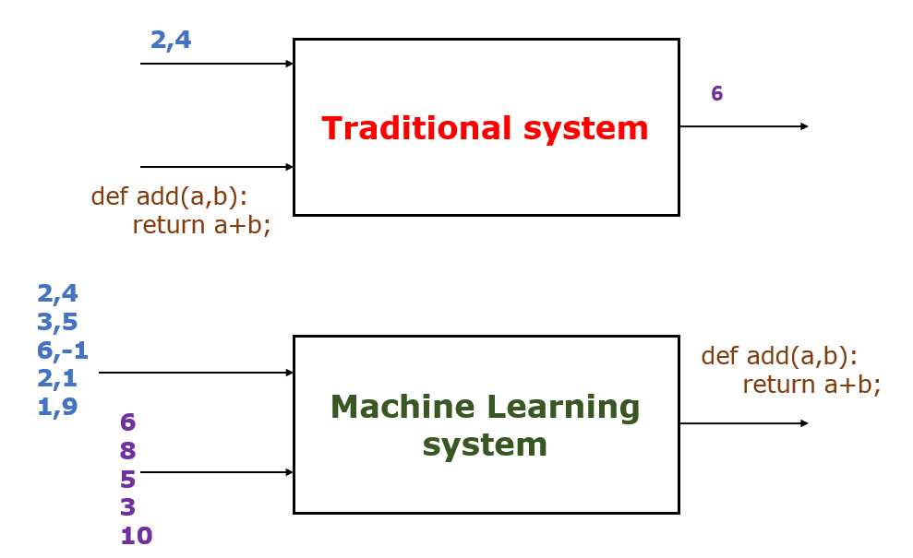
What is ml…..?
“A computer program is said to learn from experience E with respect to some class of tasks T and performance measure P if its performance at tasks in T, as measured by P, improves with experience E.” Tom Mitchell, Carnegie Mellon University

Slide 4
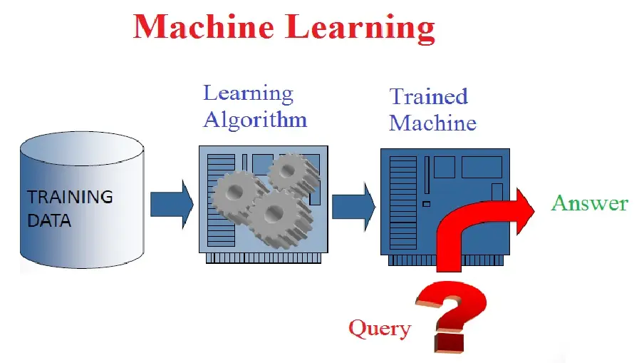
ML

Slide 5
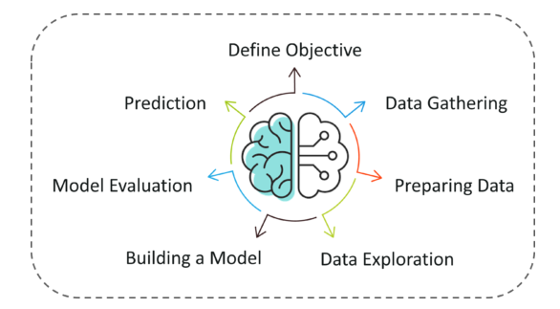
Machine Learning Process

Slide 6
Machine Learning Process
Step 1: Define the objective of the Problem Statement
Step 2: Data Gathering
Step 3: Data Preparation
Step 4: Exploratory Data Analysis
Step 5: Building a Machine Learning Model
Step 6: Model Evaluation & Optimization
Step 7: Predictions

Slide 7
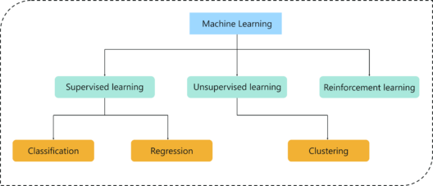
Type Of Problems In Machine Learning

Slide 8
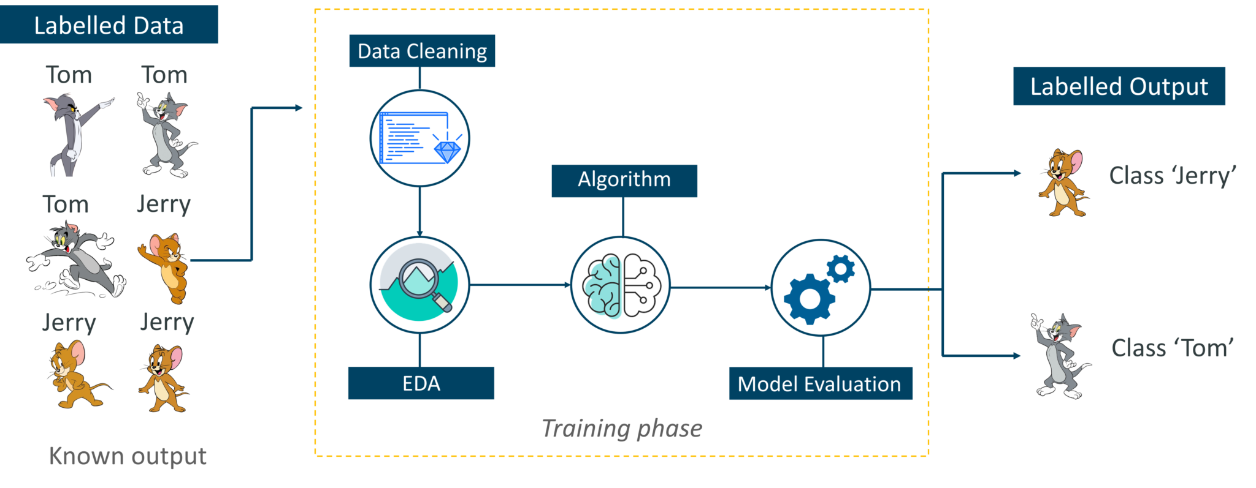
Machine Learning Types
Supervised Learning
Supervised learning is a technique in which we teach or train the machine using data which is well labeled.

Slide 9
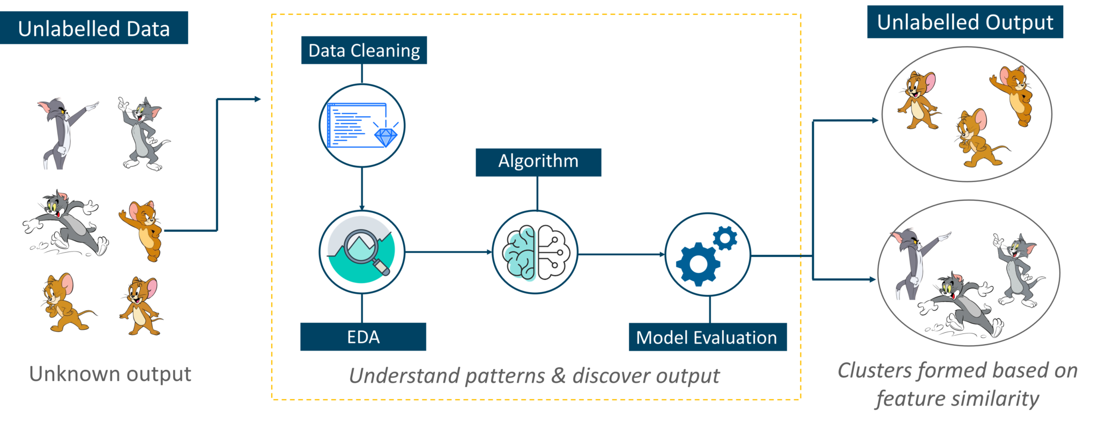
Unsupervised Learning
Unsupervised learning involves training by using unlabeled data and allowing the model to act on that information without guidance.

Slide 10
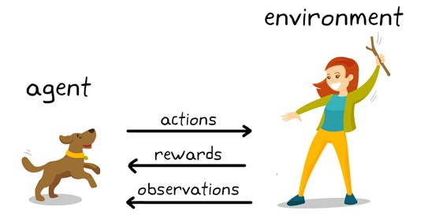
Reinforcement Learning
Reinforcement Learning is a part of Machine learning where an agent is put in an environment and he learns to behave in this environment by performing certain actions and observing the rewards which it gets from those actions.

Slide 11
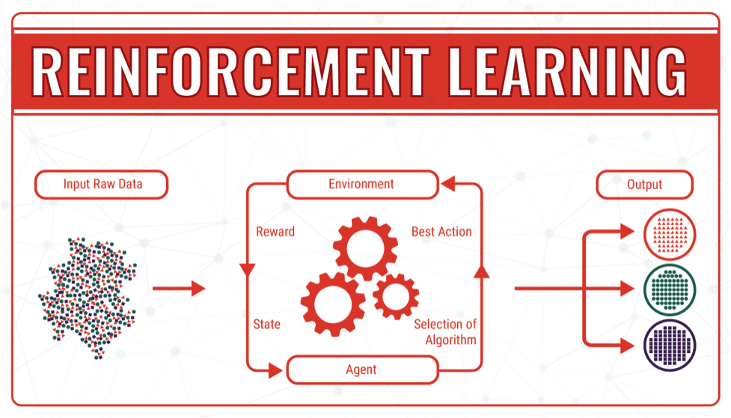

Slide 12
Application of Ml
Spam filtering
Credit card fraud detection
Digit recognition on checks, zip codes
Detecting faces in images
MRI image analysis
Recommendation system
Search engines
Handwriting recognition
Scene classification

Slide 13
Why python for ml is used?
1. A great library ecosystem
2. A low entry barrier
3. Flexibility
4. Platform independence
5. Readability
6. Good visualization options
7. Community support
8. Growing popularity

Slide 14
Python lib for Ml
Scikit-learn
Numpy
Pandas
Keras
TensorFlow
Matplotlib
NLTK
Scikit-image
PyBrain
Caffe
StatsModels

Slide 15
Algorithm
KNN
K mean
Logistic Regression
Linear Regression
NB
SVM
Decision Tree

Slide 16
References
https://www.edureka.co/blog/introduction-to-machine-learning/
https://towardsdatascience.com/8-reasons-why-python-is-good-for-artificial-intelligence-and-machine-learning-4a23f6bed2e6
https://towardsdatascience.com/the-7-steps-of-machine-learning-2877d7e5548e

